Slide 1
FireAI
A Wildfire Prediction System
Rowan, Nathan & Josh

Slide 2
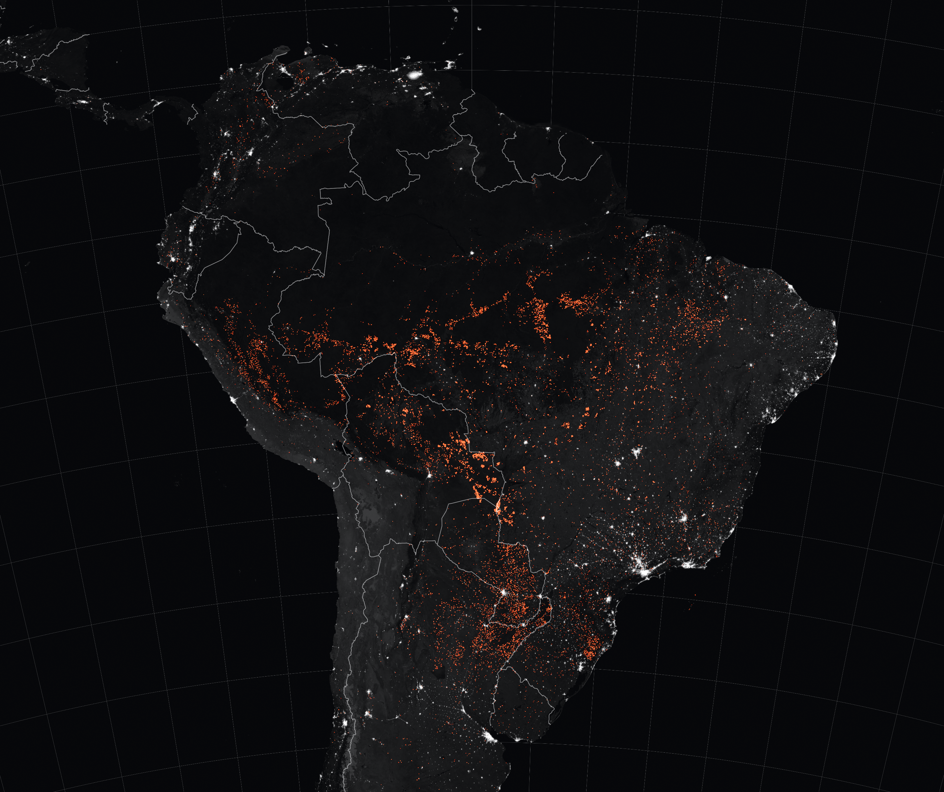
Wildfires
Cause significant environmental damage while threatening human lives.
Hard to control due to fuel available (dry underbrush and deadwood) and rapidly changing environmental conditions.
California:
Amazon Rainforest:
Largest wildfire season on record
8000+ forest fires burning an area of
1 million acres
Caused by illegal deforestation
Required an international response with 20million in funding

Slide 3
FireAI - Predicting Wildfires
Our Idea: Train a Supervised Binary Classification Model to predict the Burn Area of a forest fire in a particular park location, based of the current environmental conditions
Input features we look at;
Temperature (Celsius)
Humidity (%)
Wind Speed (km/h)
Rain (mm/m2)
Month
Additional indexes from the Forest fire weather (FWI) index
Output: Yes/No if a fire requires an immediate response to prevent rapid growth

Slide 4
FireAI – Who we target
Model is trained on wildfire datasets from the Montesinho Natural Park in Portugal.
Target demographics:
We would require National Parks to monitor and record the necessary input features using their own low cost sensors to make predictions
National Parks - to identify wildfires with the potential to threaten humans and wildlife, before they develop into an uncontrollable state
Fire Management Systems – Improve firefighting resource management. For instance, as small fires are predicted, helicopters/planes could be spared and small ground crews could be sent

Slide 5
Final Note
In future, we would need to expand our current dataset to achieve consistently accurate predictions across multiple parks
Furthermore, a linear regression model may provide more information on the severity of the fire as well as scale

